Slide 1
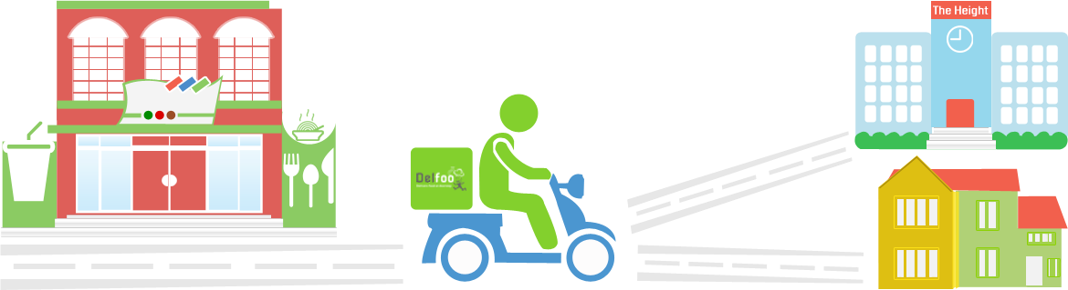
ZipShoppe
You Local Shopping and Delivery Network

Slide 2





Leveraging Trusted Network for Shopping Needs
Can Someone pick merchandize for me
(Buyer Initiated Flow)
Buyer
Shopper
Connected / Verified
via
N^{th} Level Connection
Connected / Verified
via
3rd Level Connection
(Shopper Initiated Flow)
I Can Pick merchandize while I am at this Shop
Buyer
Shopper

Slide 3
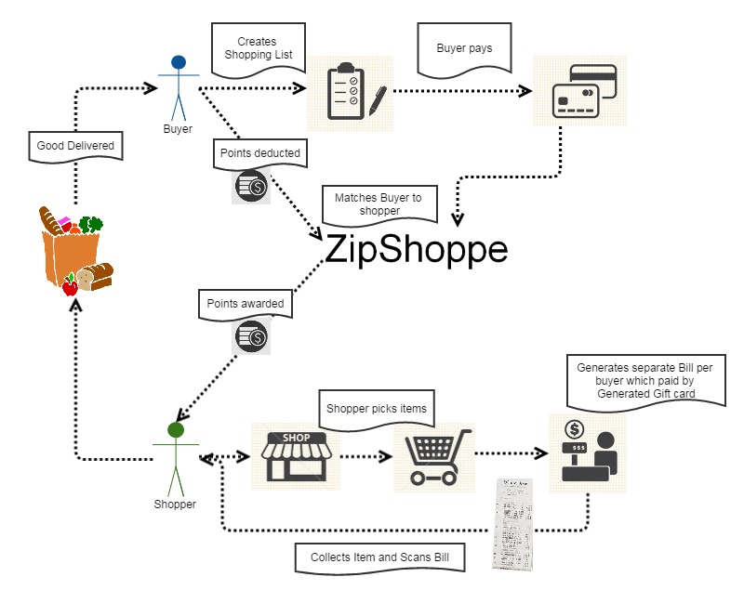
High Level Flow
TRUSTED NETWORK

Slide 4




Buyer’s Shopping Flow
Buyer
I Need
Search's: By Store Product Category, Product name
Return’s: Items with recommendation on similar product
ZipShoppe
Create Shopping List
Adds: Product to shopping List
Return’s: bill with total amount due including tax
Login?
N
ZipShoppe
Y
Register / Login
Login with one of the option
Return’s: Previously Selected Delivery Address
Selects: from pre-existing delivery options or adds New
ZipShoppe
Delivery Options
Delivery Time Window ; In 2 Hrs or In 4 Hrs
Show Shopper available from network in the selected Del Area
Payment
Options
Pay By PayPal
Transfers money
To holding account
Pay By Credit Card
Broadcast
Shopping List
Cash On Delivery
Deduct Point
Stored Instrument / Add new
Initiate Hold for
Amount due

Slide 5



Buyer Shopper Mapping Flow
Broadcast
Shopping List
Delivery Location
Broadcast option
Pre Defined Group
My Extended Network
Professional Shopper
Shopper check-in
Shopper agrees to
Payment Conditions
Delivery Conditions
Notify shortlisted
Shoppers
Shopper
Shops

Slide 6


Shopper’s Shopping Flow
Shopping List
Shares
Notification
Notifies
Buyer
Shopper
ZipShoppe
Checks of Items from list
Real Time update in App
View Shopping List
Payment
Options
Payment
Options
Cash On Delivery
Pay By Self Credit Card
Pay By Store Card
Pay By PayPal
Pay By Credit Card
P2P
Generate Fixed Value Card
Money Transfer to
PayPal Account
Cash On Delivery
ZipShoppe
Purchase Store Card
Checkout at
Store POS
Earn Points
Generate route from shop to Buyer
ZipShoppe
Delivery Instructions
Delivers Goods
Receives Goods

Slide 7


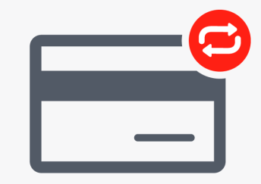

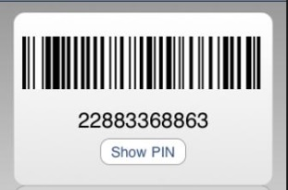
Shopping Payment Flow
  via PayPal
    Money is transferred into escrow account
    Money is converted into Store Gift card or transferred to Shopper PayPal Account
  Via Credit card
    Place hold on money
    After purchase Credit card is used to buy Store Gift card or transferred to Shopper PayPal Account
  Direct Payment when Shopper delivers Good
Buyer
ZipShoppe
Transfer P2P
Money In
Buyer
ZipShoppe
Hold / Credit
Money In
ZipShoppe
Shopper
Digitized Store Gift Card
Money Out
ZipShoppe
Shopper
Transfer P2P
Money Out
Buyer
Shopper
Cash on delivery

Slide 8
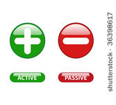


Point Flow
Registration ‘X’ number of points are awarded
Every Shopping request Buyer pays Shopper by points
Shopper earns points on every delivery
Buyer can buys points using his credit card or PayPal Account
Shopper can redeem point to bank account or PayPal account or as store credit
Shopping
Buyer
Shopper
Point Transfer
Buyer
Shopper
Point Buy
Buyer
Point Redeem
Shopper

Slide 9


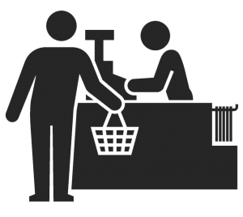
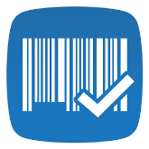

Tying it all together
Creates Shopping List
Publishes shopping List
Buyer
Buyer chooses Delivery place and Time
Buyer Pays
Zip Shoppe put hold on
Credit Card remits if shopper
collects goods
Zip Shoppe deducts point
Buyer at Home
Stores Buyer rating of shopper
ZipShoppe
Shopper deliver
Goods
Zip Shoppe awards point
Shopper
Zip Shoppe Matches buyer and
shopper based on delivery location
and shopping list
Zip Shoppe send direction
from shop to Buyers delivery address
Zip Shoppe based on Items picked
generates payments
Shopper Pays By
reloadable Gift Card
Shopper announces availability
Shopper updates Items picked
Shopper at Shop
Shopper picking Items from Buyer Shopping List
Shopper receives Payment
As Giftcard
Checkout

